Slide 1
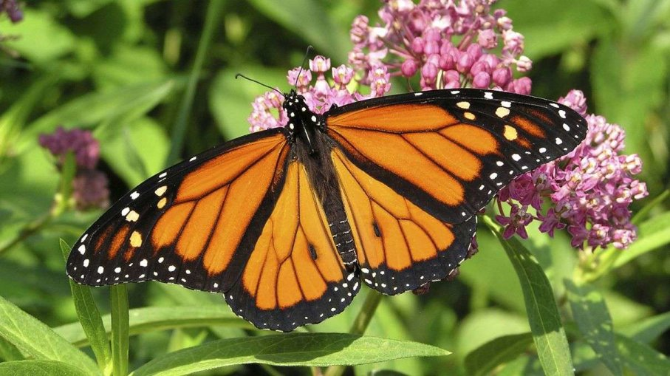
An Experimental Investigation of Local Adaptation in Common Milkweed
(Asclepias syriaca)
Emily Dougherty and Matthew Geiger
Source: https://animals.howstuffworks.com/insects/all-is-not-lost-monarchs.htm

Slide 2
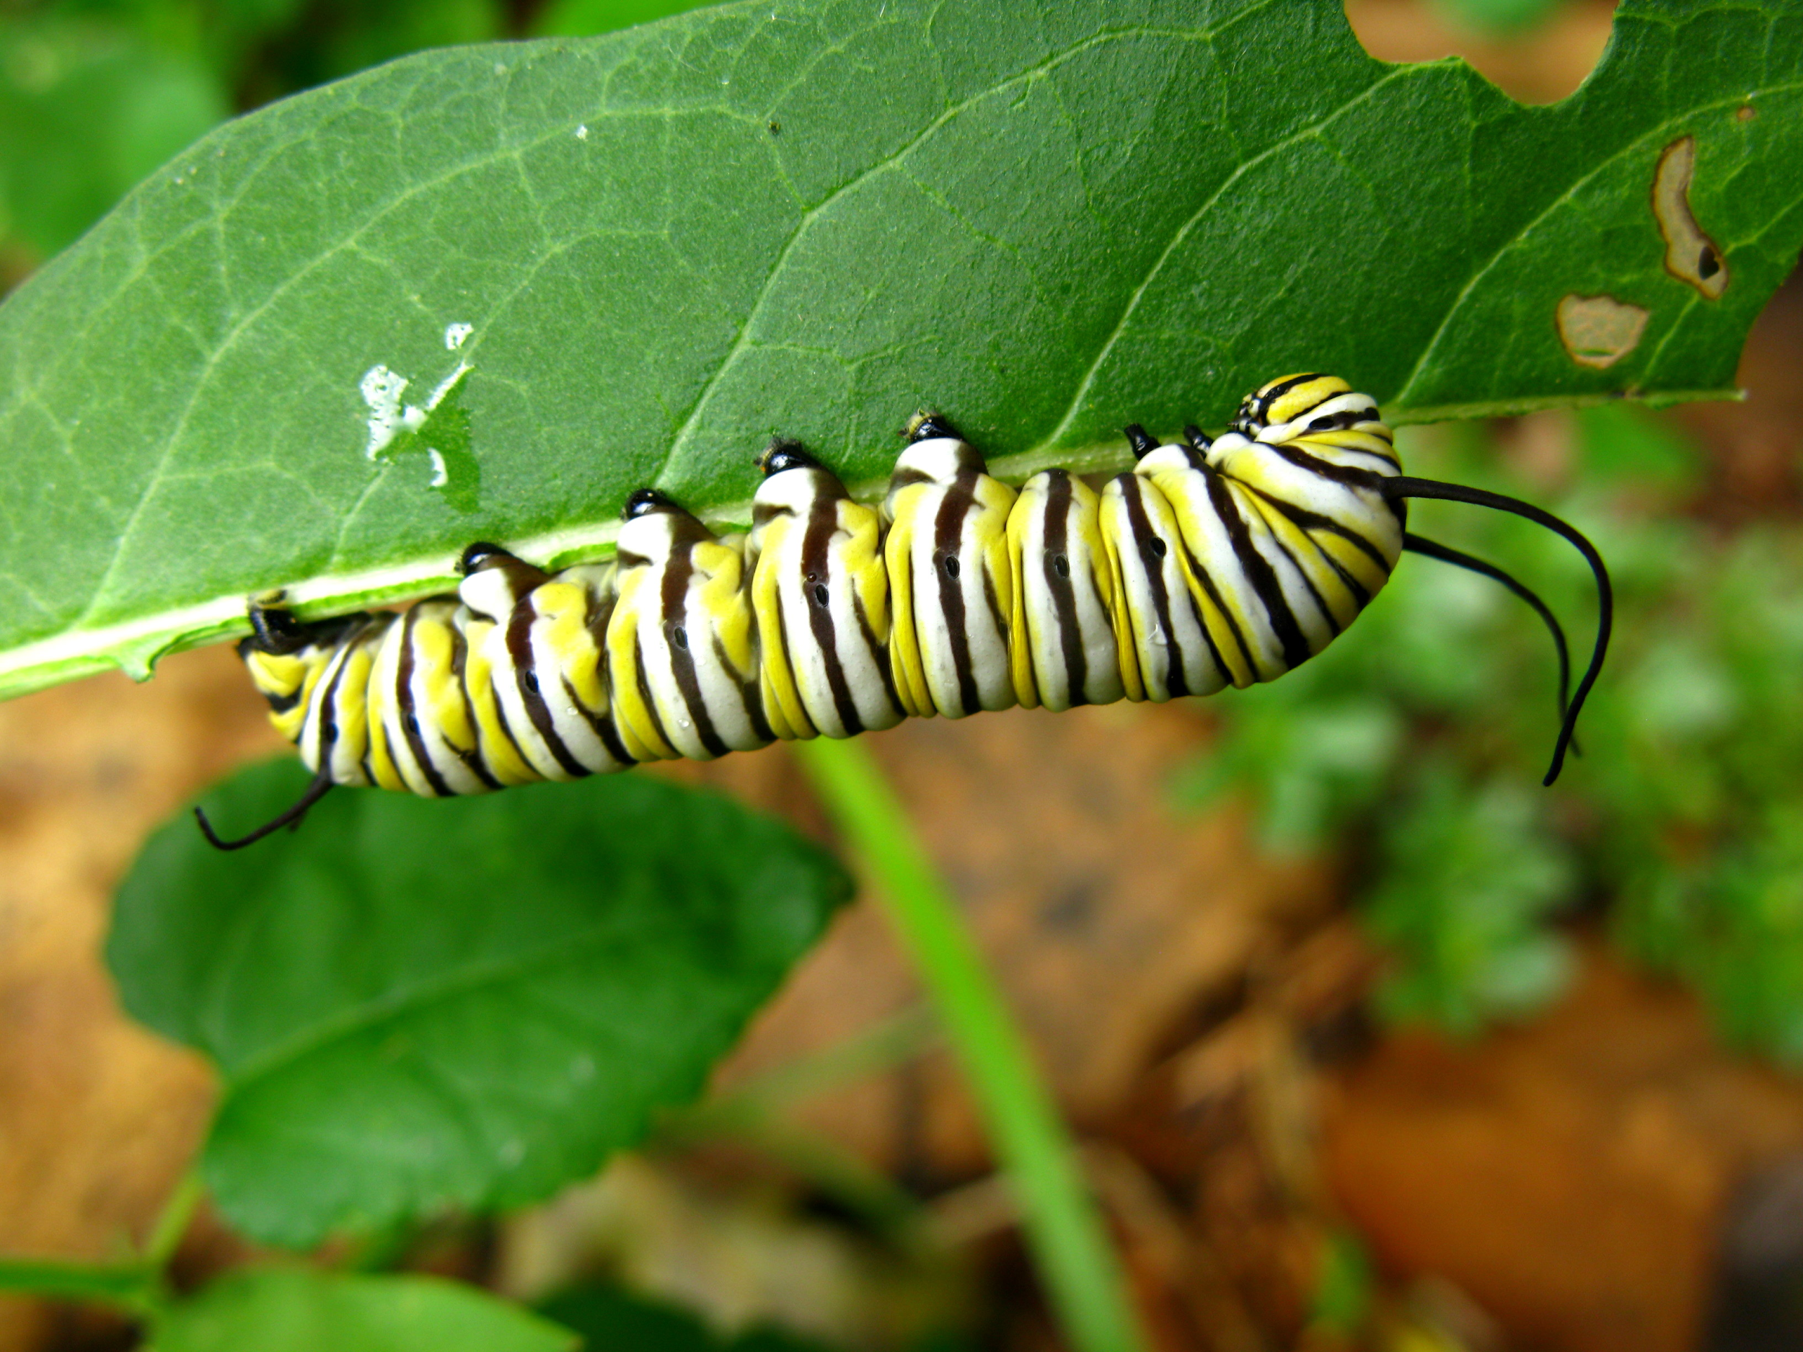
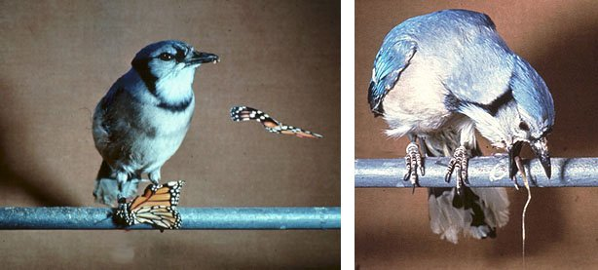
Monarchs & Milkweeds
Monarch butterfly caterpillars (Danaus plexippus) feed only on milkweeds, including common milkweed (Asclepias syriaca)
Milkweeds chemically defended against herbivory, but monarchs adapted to overcome defense
Source: https://eatreadscience.com/2015/11/08/resistance-to-plant-toxins-in-milkweed-butterflies-is-linked-to-toxin-storage-for-defense/, http://evolution-textbook.org/content/free/notes/ch21/ch21-f08.html
Notes:
Be informal/conversational, Produce thick latex full of cardenolides, disrupt Na K pump which stops heart, Monarch have adaptation which prevents from harming them, sequester for their own protection

Slide 3
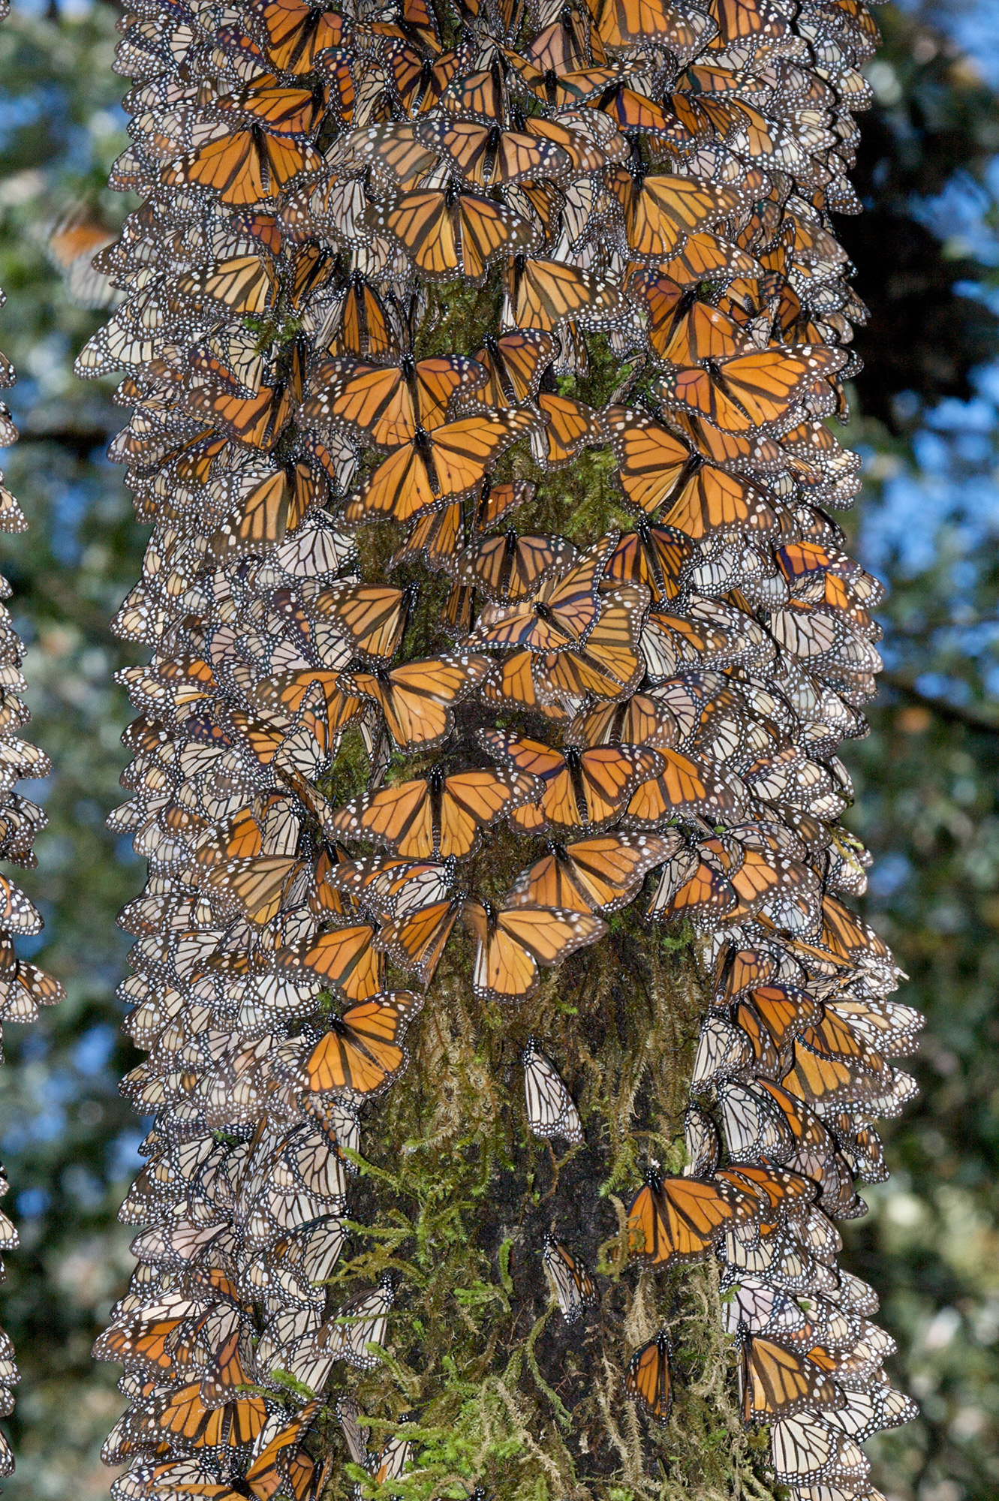
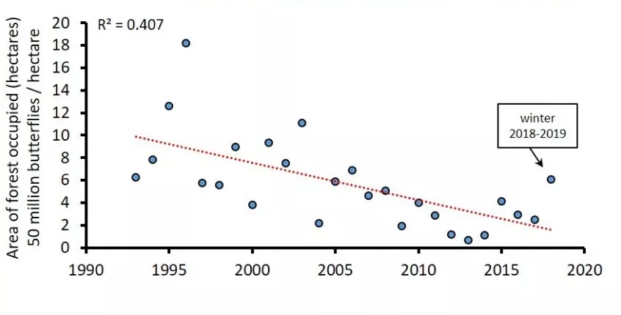
Eastern Monarch Populations are Declining
Source: Monarchs and Milkweed, https://www.floridamuseum.ufl.edu/event/expedition-monarchs-andrei/
Notes:
Eastern migratory population, in overwintering grounds in Mexico over past 20 years, You may have heard of this but In recent years monarch populations have declined. Populations fluctuate from year to year but overall there is a decline. It is hypothesized that this could be caused by limited access to milkweed on this long journey, state hypothesis, limits monarch population. DONT MENTION LOSS OF MEXICO HABITAT. There are sev hypothesis, one of which is milkweed

Slide 4
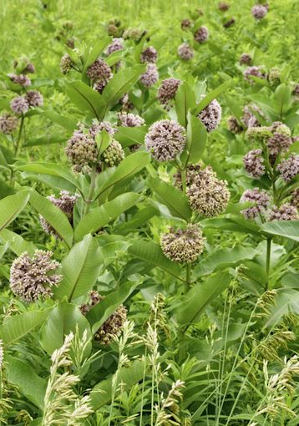
Why are Populations Declining?
Milkweed limitation hypothesis: Loss of common milkweed is preventing monarchs from breeding
Seeds being distributed to increase milkweed population size
Potential problem: source populations may be adapted to local environmental conditions
Local adaptation is commonly documented in plants, but whether biotic or abiotic factors are driving this is unclear
Goal of study: to determine if there is evidence of local adaptation in common milkweed
Notes:
Several hypothesis, one of which is …
Say: Milkweed have large range, mention genetic differences. if plant seeds from elsewhere that aren't adapted to local conditions, they may not grow as well
Say: agencies are distributiong seeds, but abiotic vs biotic selection agents, which is more important for local adaptation isnt well resolved, both influence evolution of the plants. what isnt understood is what drives it, purpose of this study
To do that we employed cG experiment

Slide 5
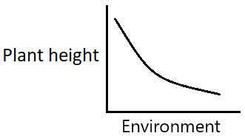

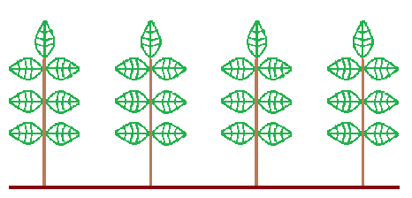
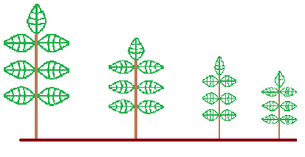
What is a Common Garden Experiment?
A
Common Garden: plants from each location grown in one environment
B
C
D
A
B
C
D
A
B
C
D
Populations not genetically different
Populations are genetically different
Notes:
A-D= populations and locations, not individual plants. cG experiments commonly used in ecology, allow to determine if variation btwn and among populations is caused by environmental or genetic effects.
X axis: environment, 4 members of a location, same species. Variable: source population. 2 outcomes: one on left or one on right. In left population.
Same species different ecotypes, genetically distinct populations. Animate graph first, explain question, either or. Then common garden, take plants + grow in 1 location. Then botom left, 1 possible outcome. Lastly bottom right graph, other option, removed environmental differences

Slide 6
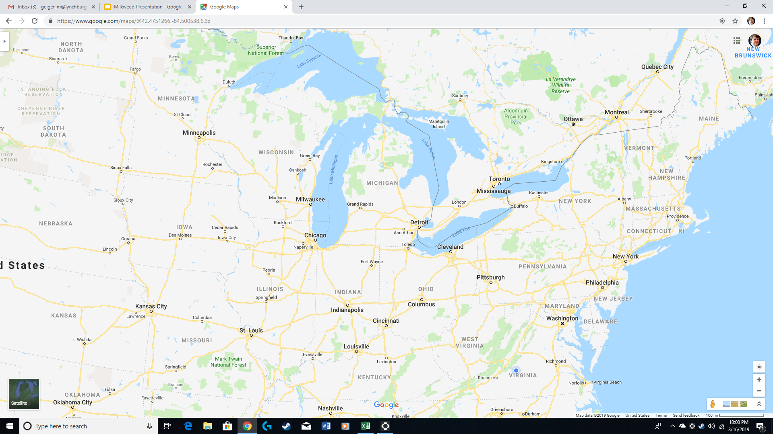
Pop. VA = Bedford, VA
Pop. OH = Granville, OH
Pop. MA = Bridgewater, MA
Pop. WI = Menomonee, WI
Pop. MN = Bemidji, MN
Populations ranged across 10.1 degrees of latitude and 23.9 degrees of longitude
MN
WI
MA
OH
VA
Source: Google Maps
Notes:
Collab with other univ we obtained seeds from 5 pops, point out where came from and range of lat + longitude, significant enough that the environments are different, growing season length shorter up N, how quickly plants grow, maritime vs continental

Slide 7
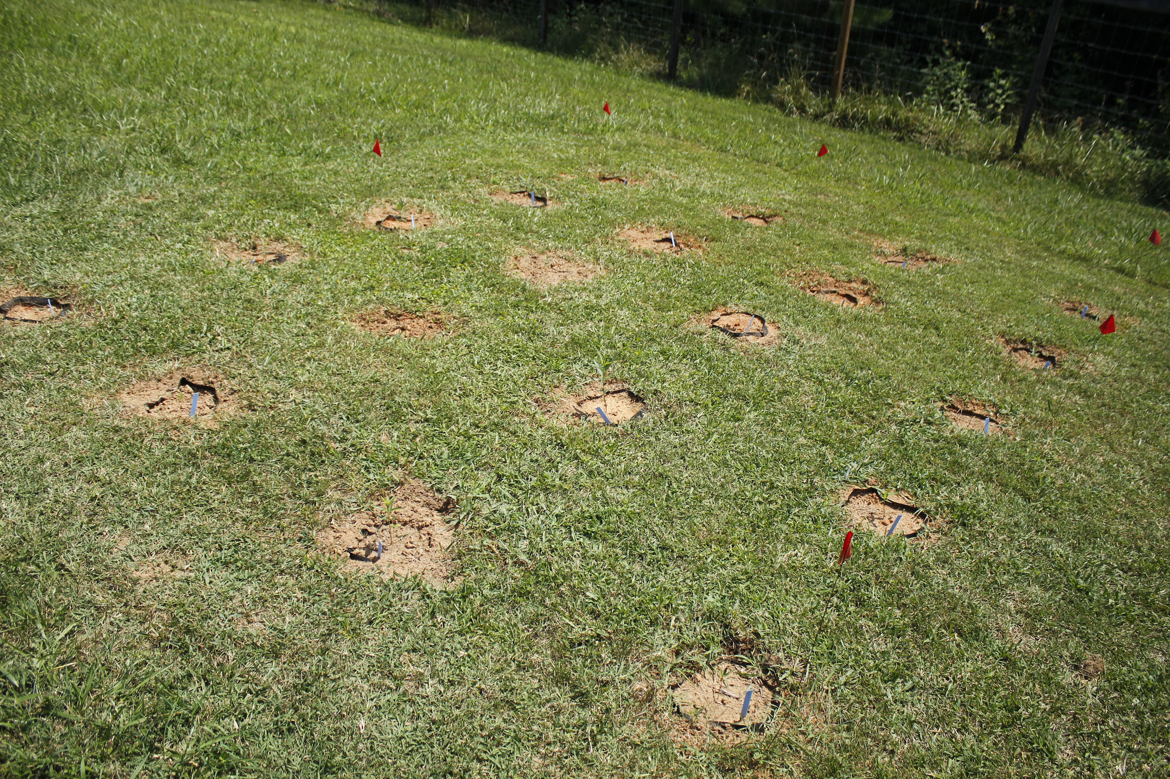
Experimental Design
Seeds germinated in lab; seedlings allowed to acclimatize for 3 weeks outside
Seedlings transplanted to common garden in 3-gallon pots
2 plots with 20 plants each
Notes:
Located at Claytor Nature Center

Slide 8
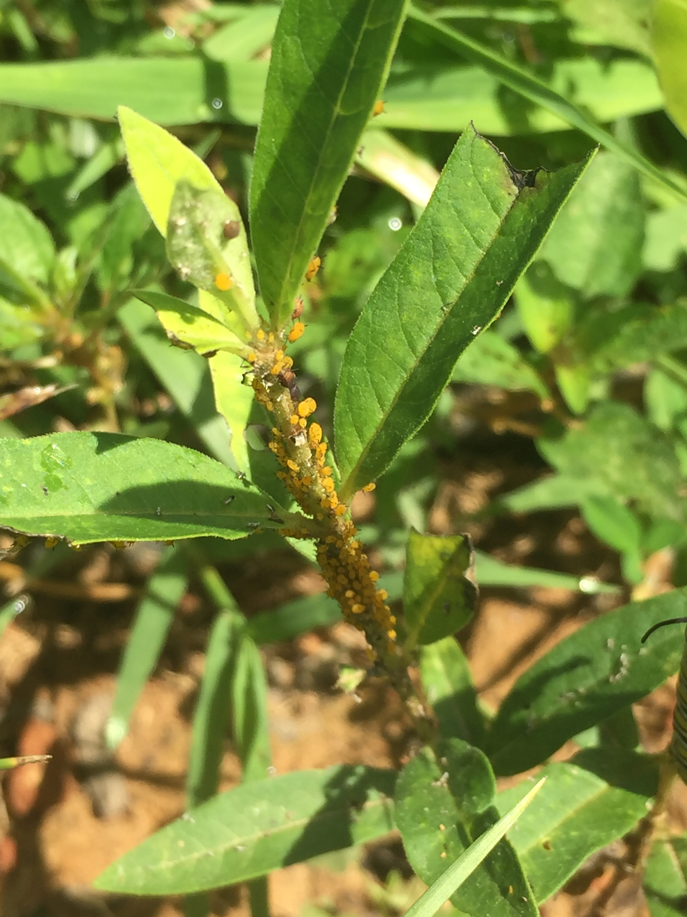
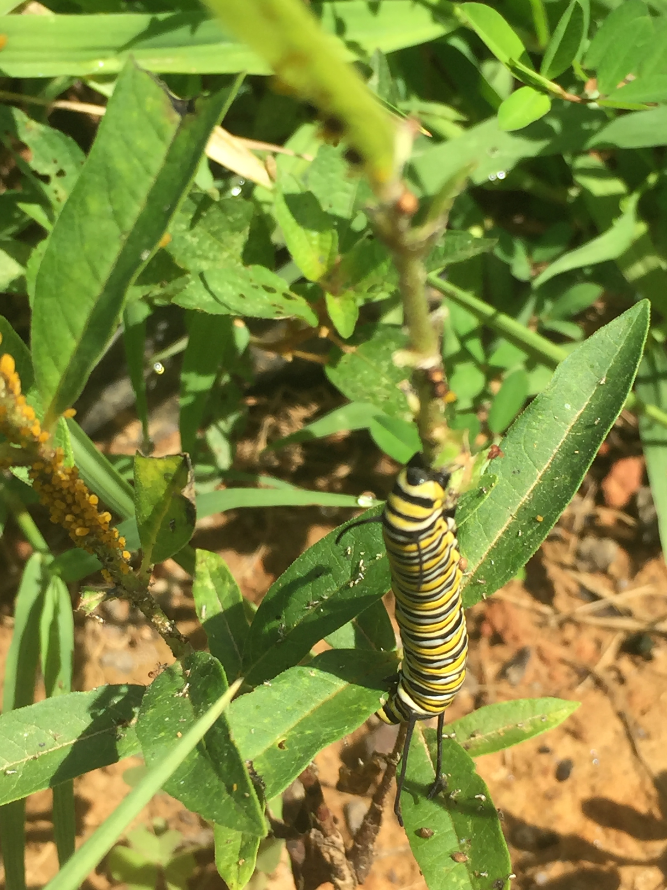
Methods
Milkweed plants measured approximately biweekly
Recorded stem height, leaf length and width, stem diameter, and number of nodes
Recorded the identity and abundance of insect herbivores and herbivore damage (leaf chewing) on each plant
Notes:
mention May-Aug (biweekly part)
We also recorded…
Transition to mention results. Now lets look at the results

Slide 9
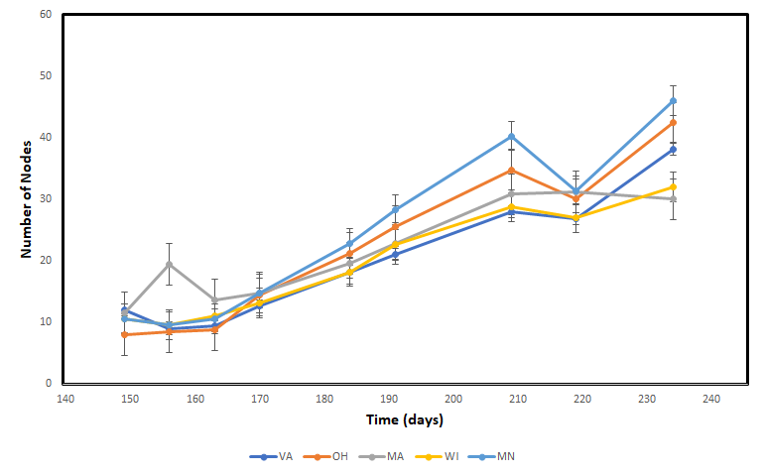
Mean Number of Nodes Varied Across Populations Over Time
population x time interaction:
F_{32,254} = 1.69 p= 0.014
Notes:
We’re going to start first with some plant growth traits. We used repeated measures anova, 5 lines = 5 populations, collect measurements for same individual over time, looking for interaction btwn effect of time and treatment which in this case is source population, significant effect of populations over time

Slide 10
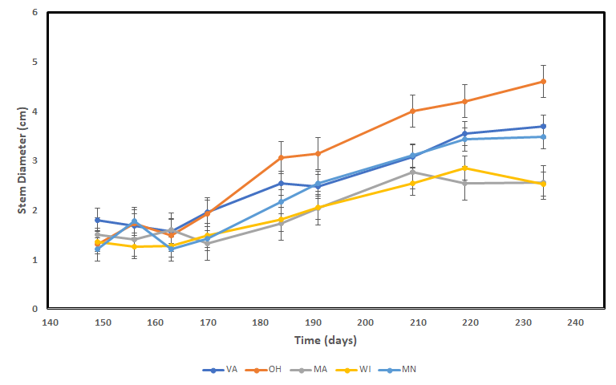
Mean Stem Diameter Varied Across Populations Over Time
population x time interaction:
F_{32,254} = 1.71, p = 0.0124

Slide 11
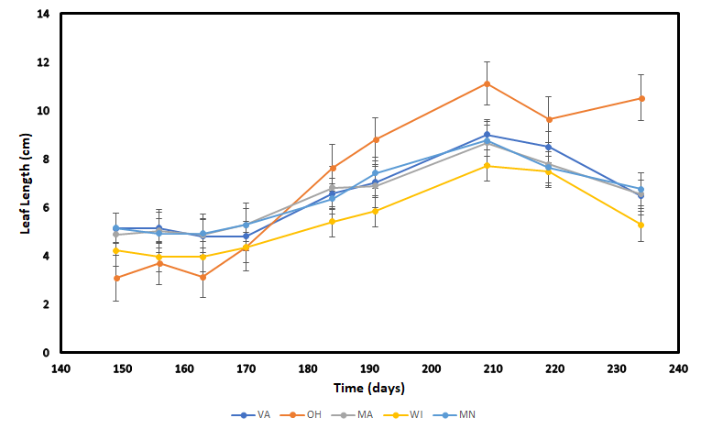
Mean Leaf Length Varied Across Populations Over Time
population x time interaction:
F_{32,254} = 1.9, p = 0.004
Notes:
In addition to height and width we also measured leaf length and width
signif longer in OH, dont mention error bars, older leaves are senessing bc of aphid damage and new leaves growing but they were shorter

Slide 12
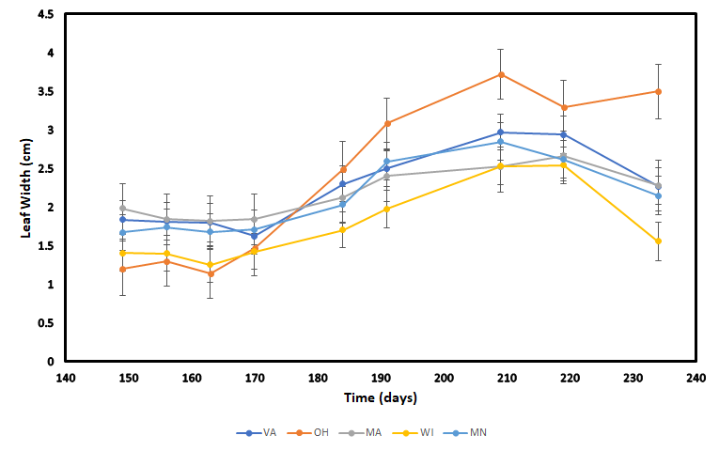
Mean Leaf Width Varied Across Populations Over Time
population x time interaction:
F_{32,254} = 1.6, p = 0.021
Notes:
Mention silimar pattern, OH had longer+wider leaves, Not just higher, higher over time, just say signif interaction

Slide 13
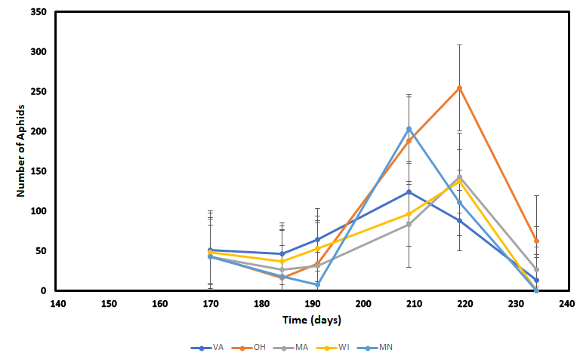
Mean Aphid Abundance Did Not Vary Among Populations Over Time
population x time interaction: F_{20,164} = 0.62, p = 0.89
Notes:
Transition: remember we also looked at abundance of herbivores and herbivory. We didnt find many herbivores but we did find aphids so were presenting analysis of aphids here. We used data later in the season bc there was nothing before, were no aphids prior to this date, aphid No. highly variable populations

Slide 14
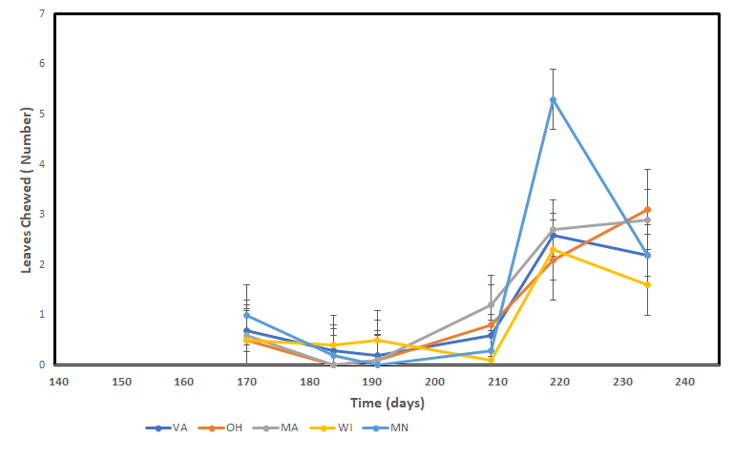
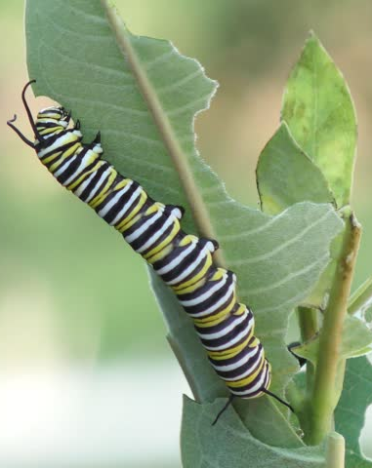
Mean Herbivory Did Not Vary Among Populations Over Time
population x time interaction: F_{18,29} = 1.33, p = 0.24
Notes:
Herbivory by leaf chewing insects or caterpillars

Slide 15
Discussion
At this point, strong suggestion of local adaptation in plant growth
  e.g., Ohio populations tended to have greater stem diameter and longer, wider leaves
  No clear pattern among other populations
High variability in aphid numbers and leaf damage
Consequences are unclear at this point, but data suggest local seed sources should be used to augment milkweed populations
First year of a multi-year study
Notes:
we shouldnt plant seeds from X in X, this is 1st year of multi year project, interesting thqt were seeing diff already in 1st year, expecting greater differences as plants mature

Slide 16
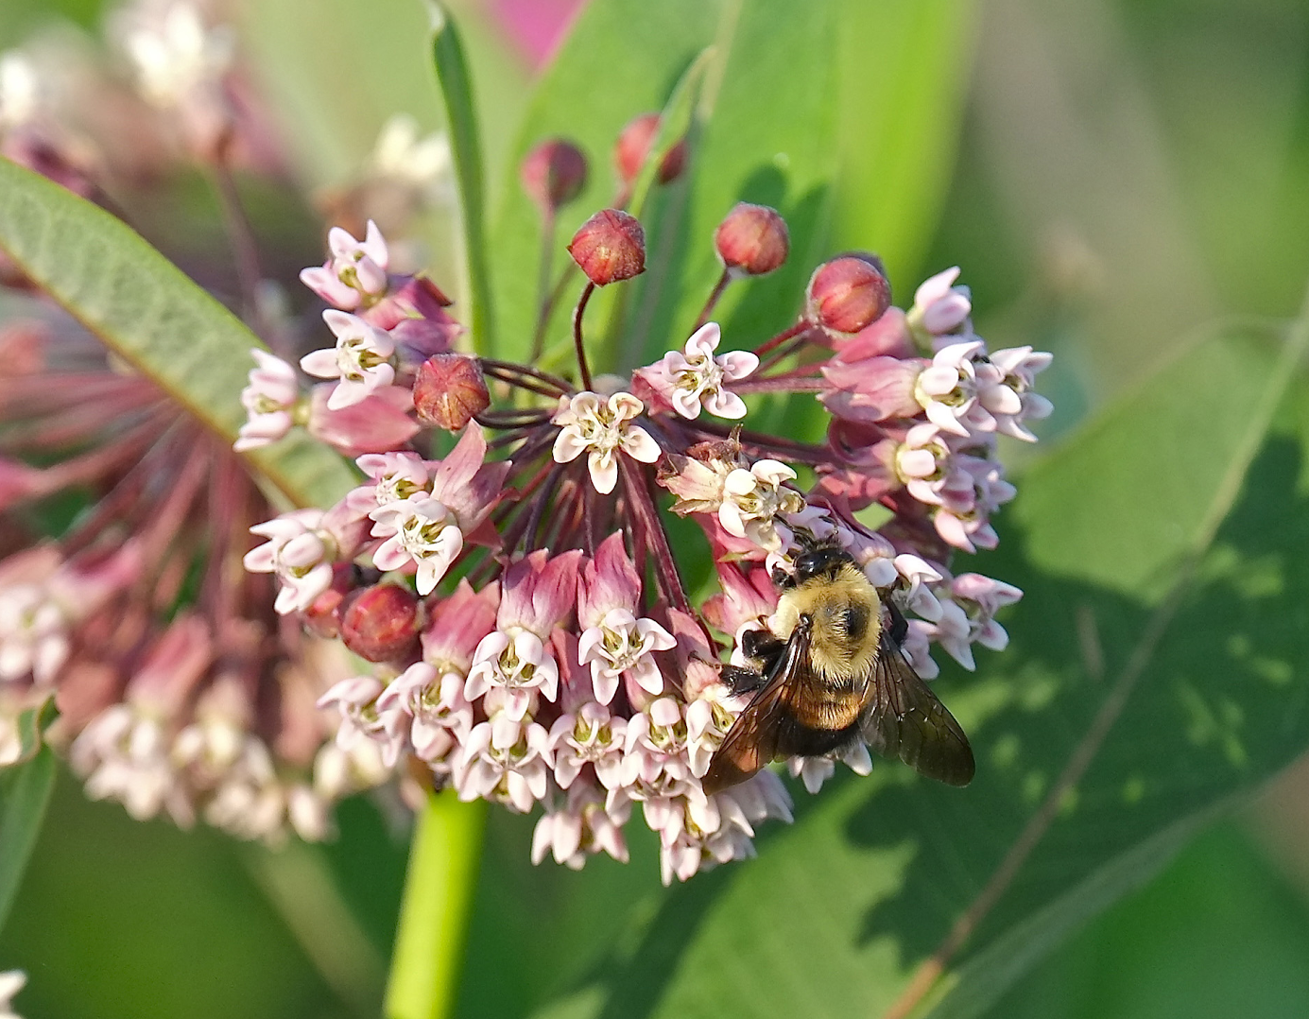
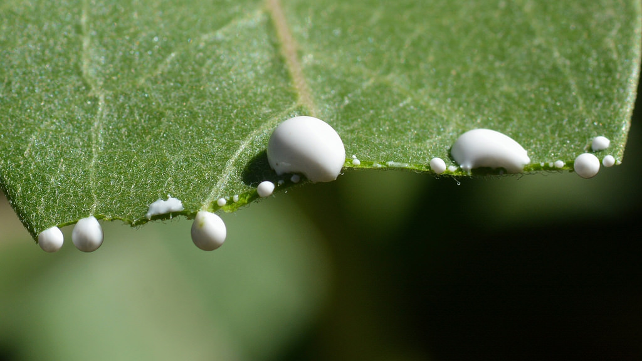
Future Plans
Measure pollinator visitation rates
Measure several plant reproductive traits
Measure plant defense traits (cardenolide content, latex flow rate)

Slide 17
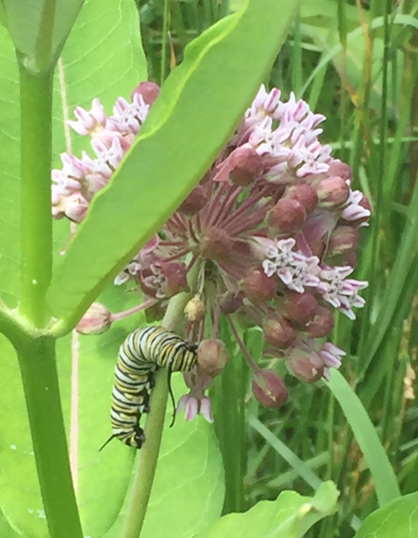
Questions?

