Slide 1
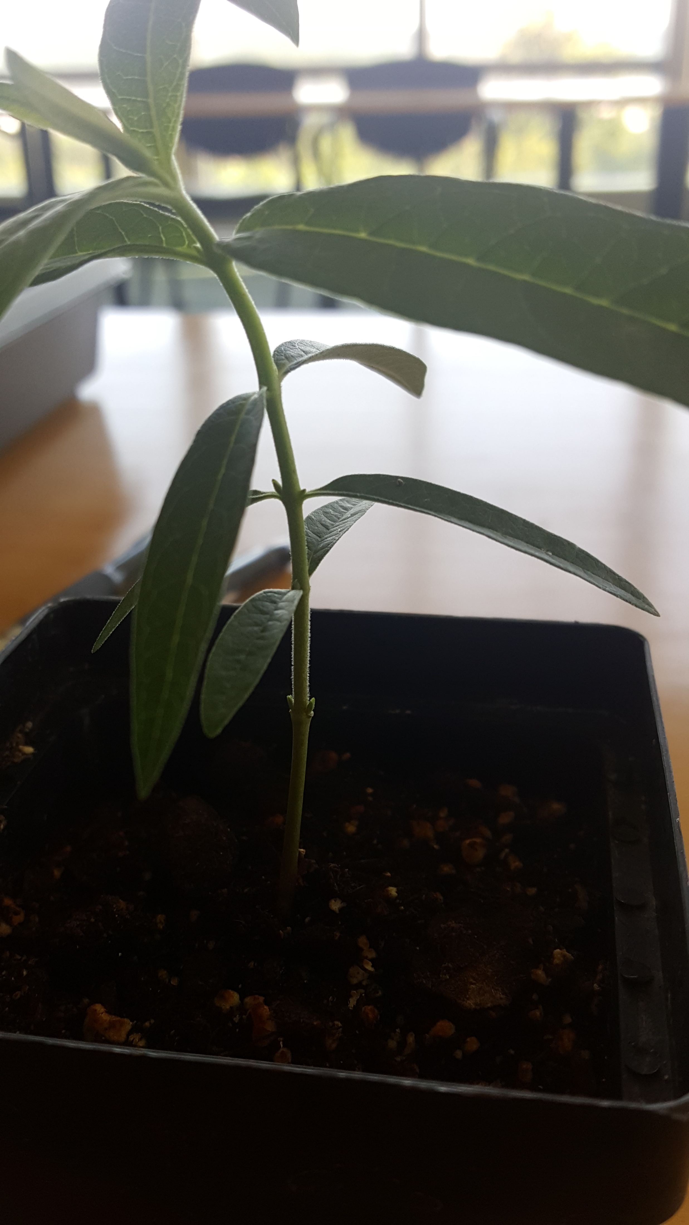
Picture 1

Slide 2
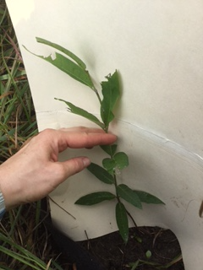
Picture 2

Slide 3
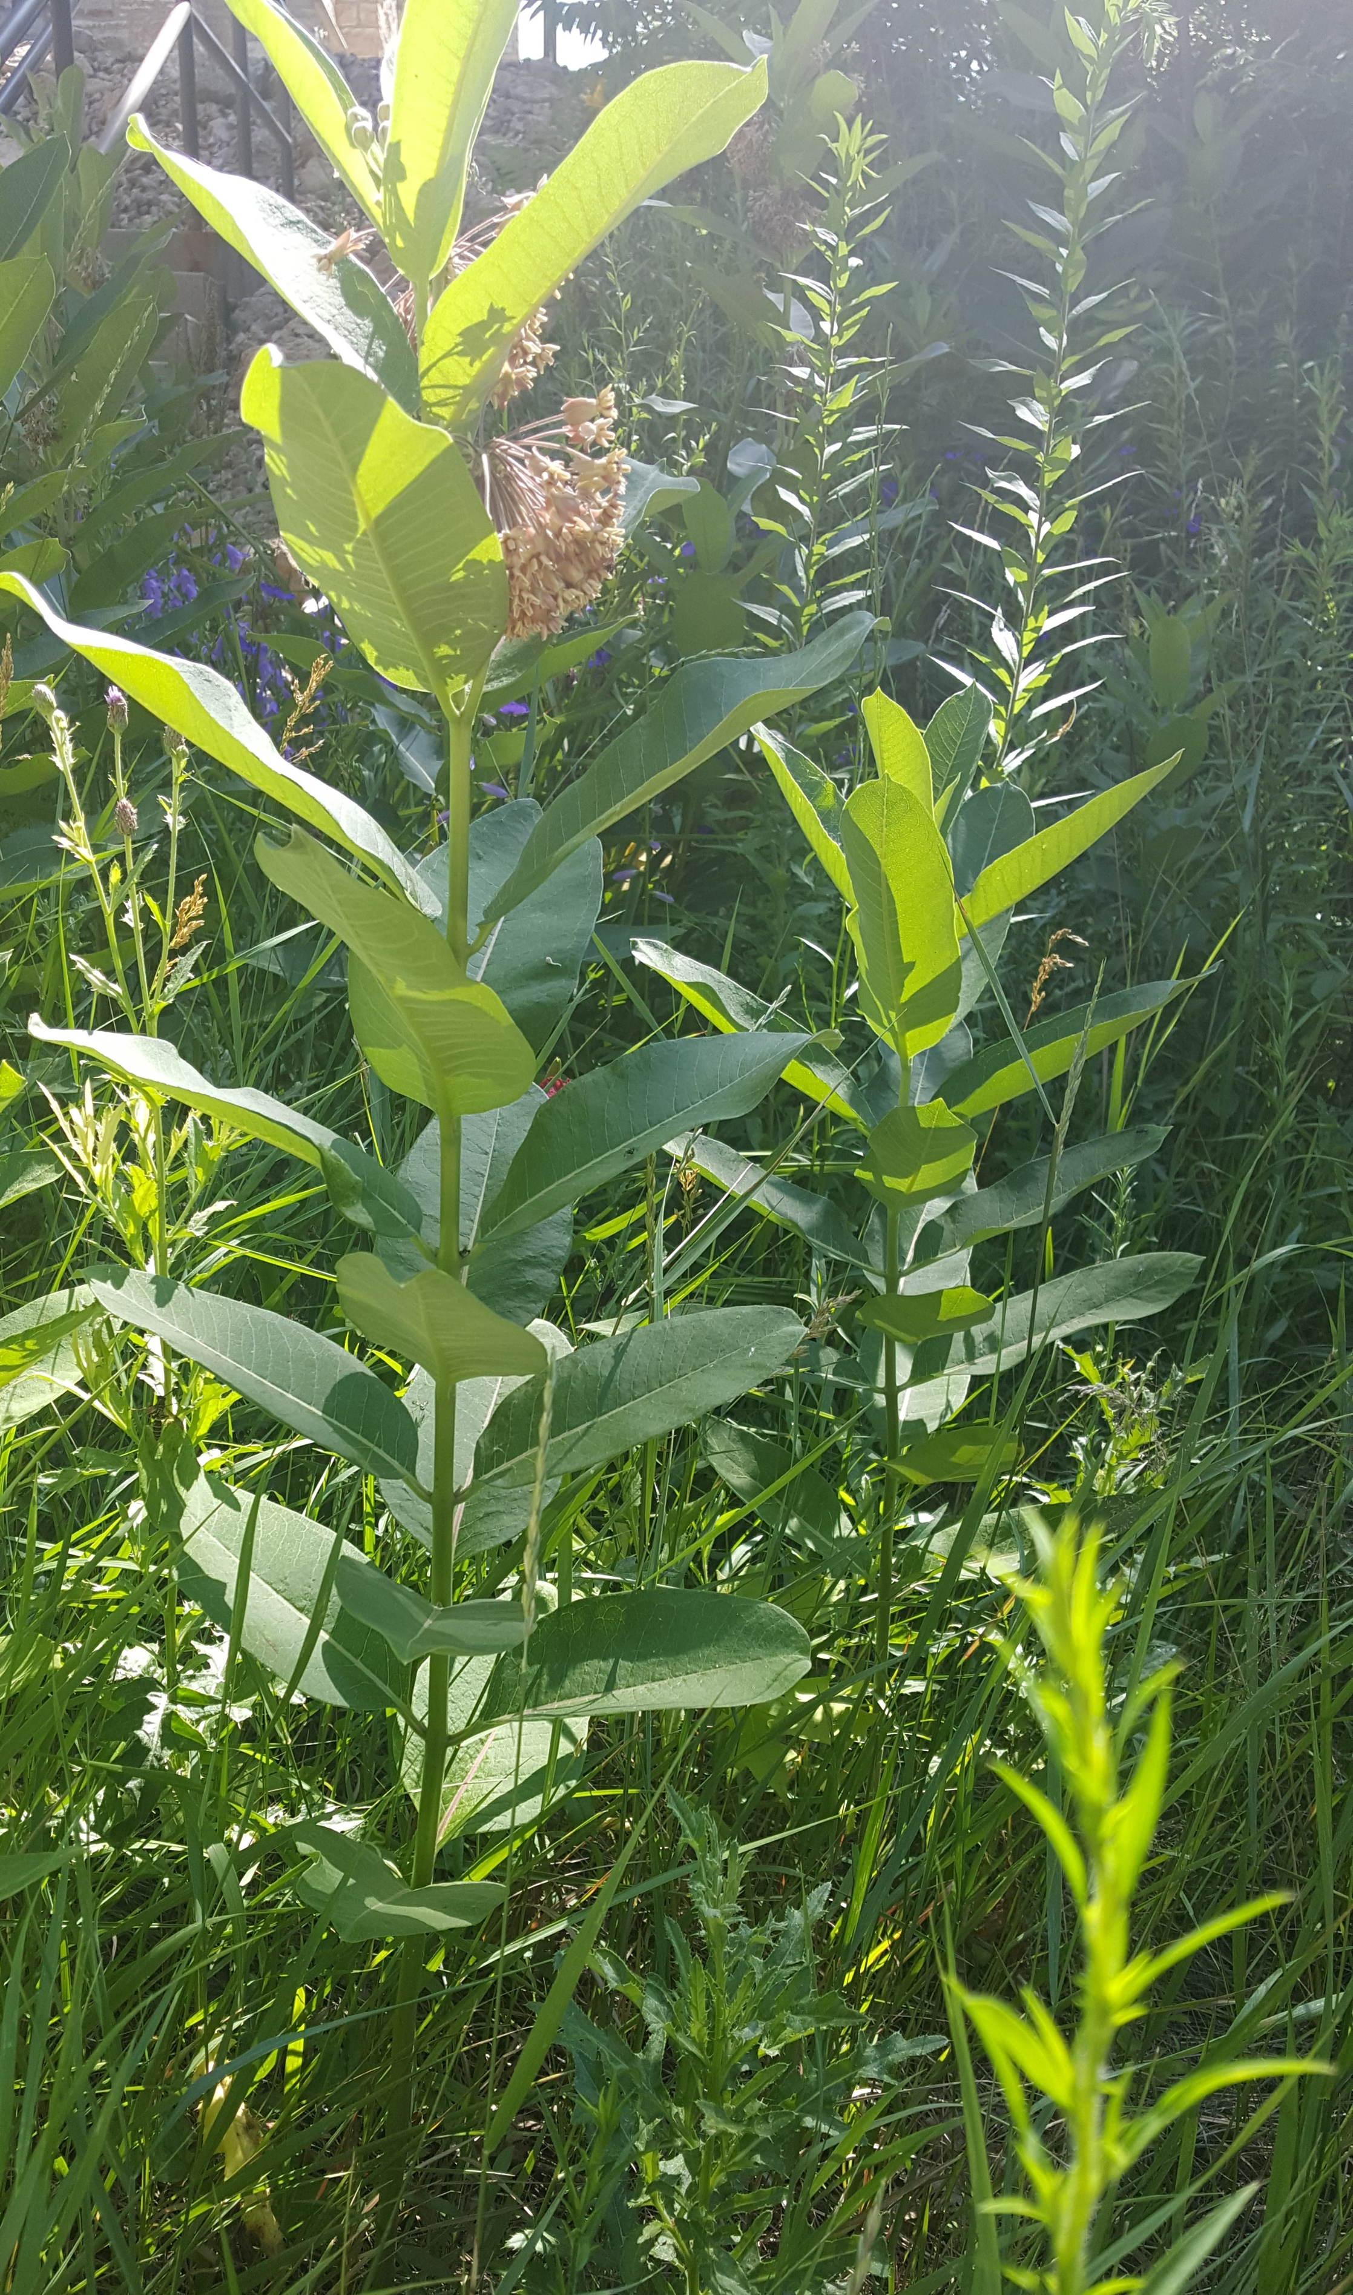
Picture 3
On this image, only count the nodes and leaves visible on the main stem because that is the only one that clearly shows up in the photo. In the field, you will count the total number of leaves and nodes on all stems.

Slide 4
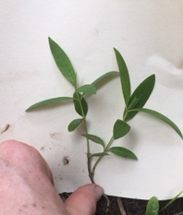
Picture 4

Slide 5
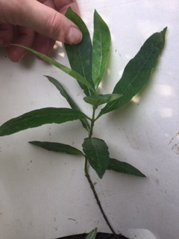
Picture 5

